Slide 1
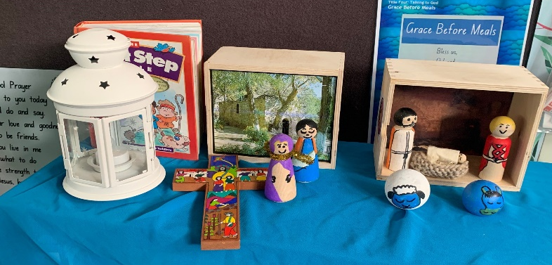
YEAR 1
TERM 2 CURRICULUM NOTE
Welcome to Term 2. All the students have had a great start to learning in Year 1 and we look forward to seeing their progress throughout this term. We are excited to be implementing a new range of classroom routines that will help to foster their learning through a range of activities. The strategies taught in our Friendology unit in Term 1 will continue to be encouraged. We ask that you assist your children in maintaining and creating positive healthy friendships. If you have any questions regarding your child please contact their classroom teacher.
IMPORTANT DATES
Wednesday 24th May – School Photos
Friday 26th May – Class Mass
Tuesday 6th June – Faith and Learning walk
SPECIALIST TIMETABLE
Homework: Monday
Classroom Sport: Monday
Creative Arts: Wednesday
PE: Wednesday
Library: Friday
Sport uniform to be worn Monday and Wednesday, full Winter uniform all other days.
REMINDER
GENERAL REMINDERS
COMPASS: All student absences must be recorded on Compass. If your child is late to school, they must be signed in at the office using the Compass kiosk, by a parent/carer. If your child is being picked up early from school, they must be signed out at the office using the Compass kiosk. Please see the attached information on how to record student absences on Compass.
Homework will commence in Week 2. Students will need to bring their homework bag in every Monday to borrow a new home reader. If they do not return their reader they will not be able to borrow a new one.
Please ensure all students are wearing the correct uniform including haircuts and shoes.
CONTACT US:
Jemma.satchell@dbb.catholic.edu.au
Janelle.pitcher@dbb.catholic.edu.au
Aleisha.fox@dbb.catholic.edu.au
Courtney.orman@dbb.catholic.edu.au

Slide 2
YEAR 1
TERM 2 CURRICULUM NOTE
Religious Education The curriculum is designed to provide children with opportunities to respond to the stories of Jesus that they encounter with their hands, hearts and minds. This is achieved via presentations, free expression, and journaling in order to draw them into the mystery of God.
Mathematics This term students will focus on building skills in working mathematically across all content areas. Students will be given lots of opportunities to develop their understanding and fluency through communicating thinking and reasoning, understanding and problem solving. They will be engaged in a range of hands on and recording tasks to help consolidate their learning as well as their understanding.
English This term we introduce paired fluency tasks that focus on students developing their skills in reading as well as a daily review that currently has a focus on phonics, oral language and high frequency words. Small group instruction is now in place to assist students in reading and comprehension. Our writing program is structured around the idea of creating texts and understanding texts. Students will be using a range of learnt concepts to create written texts.
HSIE-History In Term 2, students will explore significant people, buildings, sites and natural environments in their local area. Students learn why historical sites are important and use this understanding to investigate the importance of a local historical place. Students also examine technology from the past and how it has changed and investigate what impact it has made on people around the world.
PDHPE Students will identify and describe the feelings and warning signs that indicate they are in need of help in a range of situations. They will recall and practise the help-seeking strategies they can employ when required through a range of activities.
Science and Technology Physical World strand focuses on the identification of light, sound and heat energy, and how they are sensed and produced. This unit allows students to further develop their understanding of forces and energy and how these can be used for specific purposes in products.
Creative Arts The Visual Art unit focuses on a variety of shapes, forms, lines, structures to explore how artists interpret heat, sound and light. The main skills of this unit are drawing and print making. In CAPA this term, Year 1 are exploring music through engaging with the elements of pitch, duration and dynamics using the syllabus outcomes of performing, listening and organising sound

