Slide 1
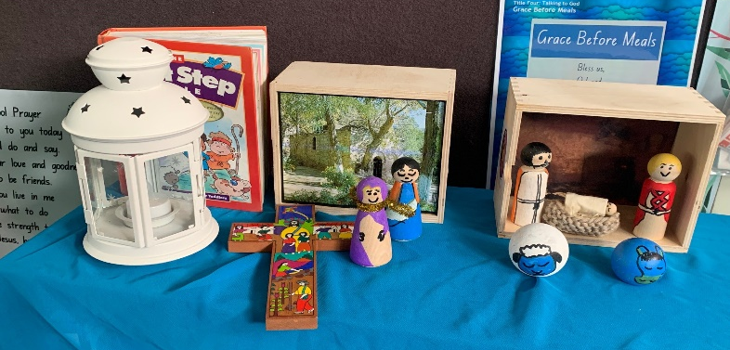
Year 3
TERM 2 CURRICULUM NOTE
Term 2 in Year 3
We are looking forward to our second term of learning in Year 3. It is a busy term with our Mother’s Day celebrations, Pentecost Liturgy and the Sacrament of Confirmation.
We are always here if you have any questions or concerns. Feel free to contact us by email or phone and we will get back to you as soon as we can.
Charlotte Broderick, Megan Mitford and Martha Butler
IMPORTANT DATES
SPECIALIST TIMETABLE
Mother’s Day Celebration: 12 May
Class Mass: 6 May
School Photos: 24 May
Pentecost Liturgy: 26 May
Class Mass: 9 June
Sacred Heart Feast Day: 16 June
Parent Teacher Interviews: 19-23 June
Stage 2 Gala Day: 20 June
Music/Drama: Miss Greig - Thursday
PE: Miss Duck - Thursday
Classroom Sport: Wednesday
Library: Monday
Inquiry Based Learning: Mrs Harrison and Mrs Rudd- Wednesday and Thursday
REMINDER
GENERAL REMINDERS
COMPASS: All student absences must be recorded on Compass. If your child is late to school, they must be signed in at the office using the Compass kiosk, by a parent/carer. If your child is being picked up early from school, they must be signed out at the office using the Compass kiosk. Please see the attached information on how to record student absences on Compass.
Sport uniform (with white sport shoes) to be worn Wednesday and Thursday.
Full Winter uniform (with black leather shoes) all other days.
Please pack fruit break in a small separate container to be kept on the desk during the morning.
CONTACT ME:
broderick1@dbb.catholic.edu.au
megan.mitford@dbb.catholic.edu.au
martha.butler@dbb.catholic.edu.au

Slide 2
Year 3
TERM 2 CURRICULUM NOTE
Religious Education Students will learn about the Sacramental traditions of the Catholic Church with an emphasis on Confirmation. They will develop their understanding of Catholic prayer and liturgical action, and how participation in sacramental life leads to a deeper relationship with God. Students will discover the origins of Confirmation in the Pentecost story, linking the scripture passage to their own daily lives. This unit will support the learning of the students who will receive the Sacrament of Confirmation with the parish throughout this term.
Mathematics Students will engage in active problem solving using concrete materials and applying previous understanding to further develop their knowledge of mathematical concepts. Areas of focus in Number this term will be Multiplication and Division, Fractions and Decimals, and Patterns and Algebra. Students will also focus on areas of Measurement and Geometry and Statistics and Probability, including Area, Chance, Angles and 2D Shapes. A daily review will support students' mental computation and mathematical fluency in areas of place value, counting, time and recall of number operations.
English Students will be focused on reading fluency on texts levelled at their decoding ability. They will participate in whole class focus lessons teaching phrasing, accuracy, intonation, punctuation and reading rate. This will lead to opportunities for students to present their reading to the class. Writing and Representing will incorporate our Science and Technology unit, with students composing informative texts such as information reports and explanations. Features of these texts that will be explicitly taught include facts, subject-specific vocabulary and descriptive language. Students will continue to learn phonic-based spelling. They will learn to recognise and apply focus sounds and their corresponding letter-patterns through daily revision and application.
HSIE-History/Inquiry Based Learning In Term 2, students will continue to study and sequence chronologically the early years of European settlement, identifying and explaining the cause and effects of European settlement. A key focus is developing student’s skills in source analysis and determining accuracy and reliability of information by understanding perspectives. Students will develop an understanding of the impact of British colonisation on Aboriginal and Torres Strait Islander Peoples when researching and evaluating information.
PDHPE The focus of our health unit this term is to teach students about healthy decision making regarding the food they consume. Students will learn about balanced diets and the way their physical body, wellbeing and energy levels are affected by different food types. They will name positive ways they can enhance their own personal health and wellbeing. Basketball clinics during Class Sport will give students the opportunity to learn skills including throwing and catching, dribbling, teamwork and game play.
Science and Technology In this unit, students will discuss the observable features of living and non-living things and learn to classify them into groups. Students will also learn how environments and living things are interdependent and what our impact as humans is on the environment around us. Students will question, plan and conduct scientific investigations into how humans can increase the growth of plants and animals for human use. Elements of digital technology and needs based problem solving are incorporated into the lessons.
Creative Arts In CAPA this term, Year 3 are exploring music through engaging with the elements of pitch, duration, structure, tone colour and dynamics using the syllabus outcomes of performing, listening and organising sound. In Visual Arts, students will be learning to appreciate three-dimensional art. They will have the opportunity to use 3D materials to create collages, sculptures and print making techniques, including bamboo and tissue paper.

