Slide 1
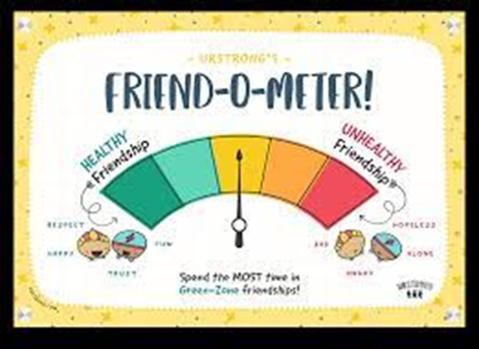
Year 5
TERM 2 CURRICULUM NOTE
Term 2 Year 5
Welcome back to Term 2. This Term we invite our Year 5 families to join us in celebration at both our Mother’s Day Mass and Faith and Learning Walk.
Below you will find an outline of what Year 5 will be focusing on in each Key Learning Area this term, as well as information relevant to our class. We are developing new learning experiences in English and Mathematics for implementation of the Year 3-6 Curriculum reform in 2024.
IMPORTANT DATES
SPECIALIST TIMETABLE
Friday 12 May Mother’s Day Mass and Breakfast ​
Tuesday 23 May Year 5 Faith and Learning Walk.​
Monday 12 June - Queen’s Birthday Holiday​
Thursday 22 June - GALA Day​
19 -23 June Parent Teacher interviews​
30 June Staff Development Day
Music: Wednesday
PE: Wednesday
Library: Monday
Classroom Sport: Tuesday
Sport uniform to be worn Tuesday and Wednesday, full winter uniform all other days.
REMINDER
GENERAL REMINDERS
COMPASS: All student absences must be recorded on Compass. If your child is late to school, they must be signed in at the office using the Compass kiosk, by a parent/carer. If your child is being picked up early from school, they must be signed out at the office using the Compass kiosk. Please see the attached information on how to record student absences on Compass.
Homework will commence this week and be expected to be returned the following Friday. It is important that the students take responsibility to complete all homework to establish positive work habits for high school. Please also ensure correct school uniform is worn each day including appropriate hair cuts and tied up if over the shoulder.
CONTACT ME:
Skye.nolan-brown@dbb.catholic.edu.au
Trish.Gibson@dbb.catholic.edu.au
Michele.kerr@dbb.ccatholic.edu.au

Slide 2
Year 5
TERM 2 CURRICULUM NOTE
Religious Education Faith and Learning Walk: Week 5, Tuesday 23 May at 8:45am. How can we care for God’s Creation? •Why is it necessary to care for God's Creation? •In what ways are the scriptures of Matthew relevant to our life today? •How are we challenged to care for God's creation?
Mathematics Our focus for Mathematics this term will be on identifying the steps in multi-step problems. We will be studying Angles, 3D Space, Patterns and Algebra, Chance, Data, Position, Multiplication and division. Continuation of Stage 3- Problem Solving and Math's Olympiad
English Spelling- Soundwaves Spelling and Spelling Rules Reading- We are working on reading fluency- Paired Reading and Comprehension Writing- Description, Narrative, Information Reports, Expositions will be covered with a focus on Sentence structure Speaking and Listening- Class Presentations and speaking in small groups
HSIE-History Australia as a Nation In Term 2, students will continue to study the reasons for uniting as a nation and the formation of an Australian Federation. They will study human rights, past and present, of Aboriginal and Torres Strait Islander Peoples, migrants, women and children and the key values that underpin Australia’s democracy.
PDHPE Survivor; Students will participate in a range of initiative and challenge activities that promote cooperation and teamwork. They will recognise the qualities and characteristics required to overcome personal obstacles and encourage others to achieve their best. Class Sport- Basketball Clinics.
Science and Technology Physical World-How can we make a force stronger or weaker? This unit focuses on the difference between contact and non-contact forces and how energy is transformed from one form to another. We will investigate the effects of increasing or decreasing the strength of a specific contact or non-contact force. We will explore the interrelationship between force and energy.
CAPA In CAPA this term, Year 5 are exploring music through engaging with the elements of pitch, duration, structure, tone colour and dynamics using the syllabus outcomes of performing, listening and organising sound. Our Visual Art Unit this term is called The Power of Nature. We will look at artworks that explore natural occurrences and discuss how artists create points of view. We will make drawings, prints and paintings that represent natural occurrences.

